Slide 1
STI 2018 Understanding and Addressing the HIV and STI Syndemics Epidemiology of STIs in Low- and Middle-income countries
Dr Francis J. Ndowa
Specialist Venereologist-Dermatologist
Zimbabwe
21-22 July 2018
Hall 11B, RAI Amsterdam

Slide 2
Disclosure
Relations that could be relevant for the meeting | Company names
Sponsorship or refund funds | None
Payment or other financial remuneration | None
Shareholder rights | None
Other relations | None
I have no conflict of interest relative to the subject matter of this presentation or the meeting.

Slide 3
WHO estimates 357 million new cases of four curable STIs in 15-49 year-olds in 2012
> 1 million new cases of STI / day
Curable STIs: chlamydia, gonorrhea, syphilis, trichomoniasis
Source: WHO. Global incidence and prevalence of selected curable sexually transmitted infections - 2012.

Slide 4
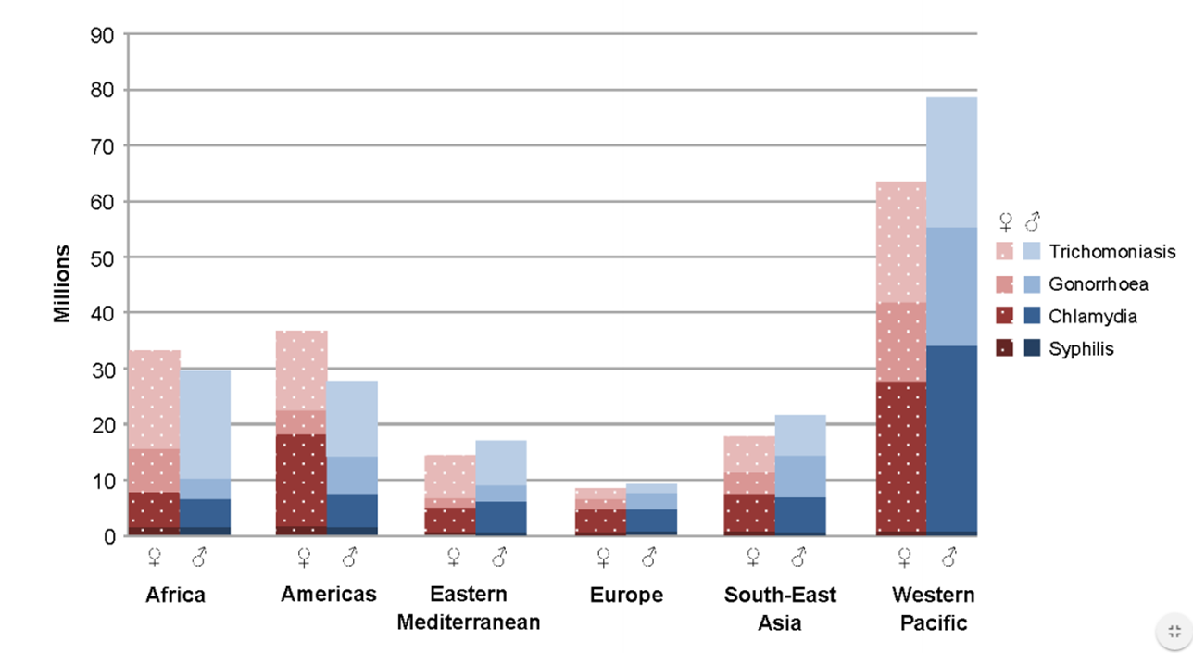
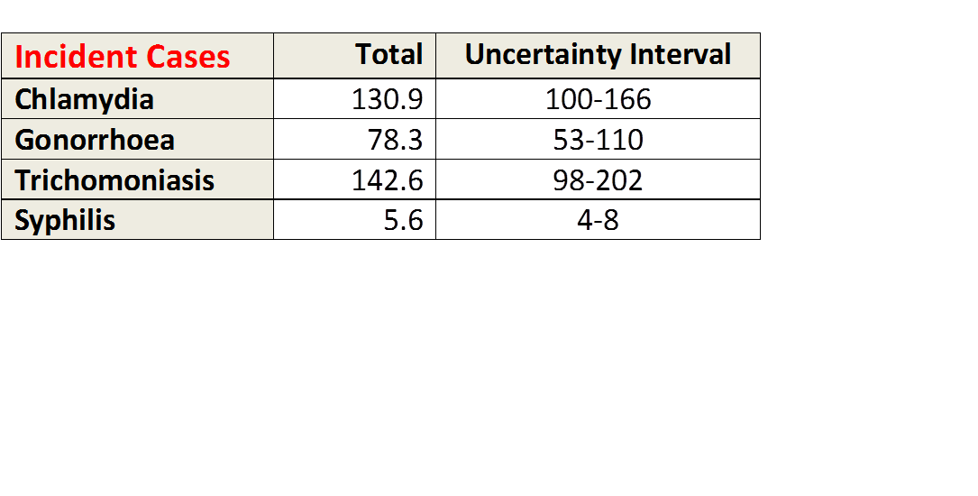
Global Incidence of 4 Curable STIs: WHO 2012
Source: WHO, Global Health Sector Strategy on Sexually Transmitted Infections, 2016-2021
Newman L, Rowley J, Vander Hoorn S, Wijesooriya NS, Unemo M, et al. (2015) Global Estimates of the Prevalence and Incidence of Four Curable Sexually Transmitted Infections in 2012 Based on Systematic Review and Global Reporting. PLOS ONE 10(12): e0143304. https://doi.org/10.1371/journal.pone.0143304

Slide 5
Prevalence of STIs in sub-Saharan Africa: Individual patient data meta-analysis of 18 HIV prevalence studies
15 – 24 years old
25 – 49 years old
BV was high among 25–49 year-olds range: 33–44%
Torrone EA, Morrison CS, Chen PL, Kwok C, Francis SC, et al. PLoS Med. February 2018.

Slide 6
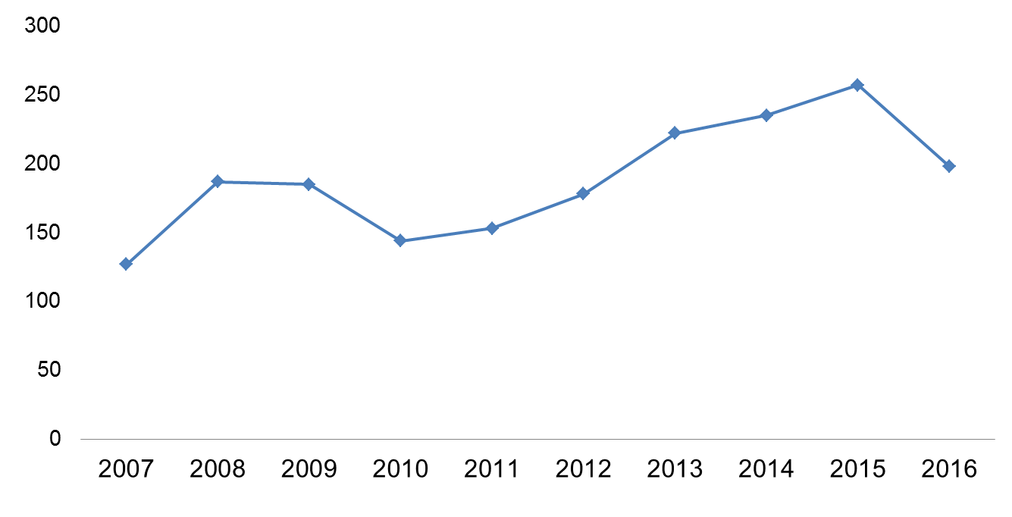
Syphilis is on the rise in a number of countries
Syphilis incidence rates 1981-2016 (Malaysia)
Case reports of syphilis per 100,000 pop. 2007-2016 (Mongolia)
Source: MoH Malaysia (2016) Surveillance data, HIV/STI/Hepatitis C sector
Mongolia National Centre for Communicable Diseases

Slide 7
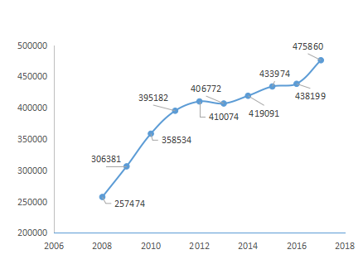
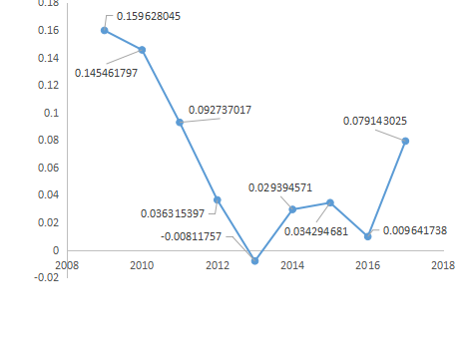
Number of syphilis cases and annual growth rate of syphilis cases reported in China from 2008 to 2017

Slide 8
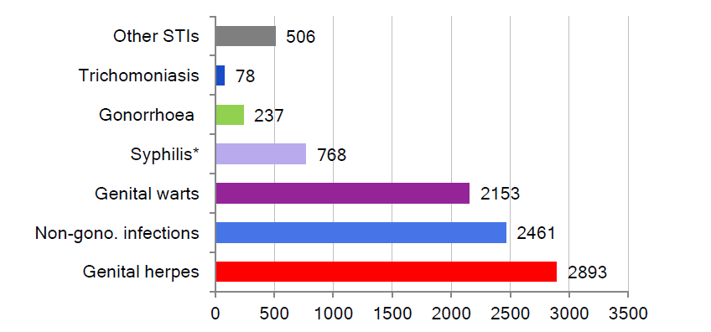
Common STIs reported to the NSACP, Sri Lanka, 2017
Source: Annual Report of the National STD/AIDS Control Programme 2017
- Dr. Ajith Karawita. MBBS, Pg Dip Ven, MD, FSLCoSHH

Slide 9
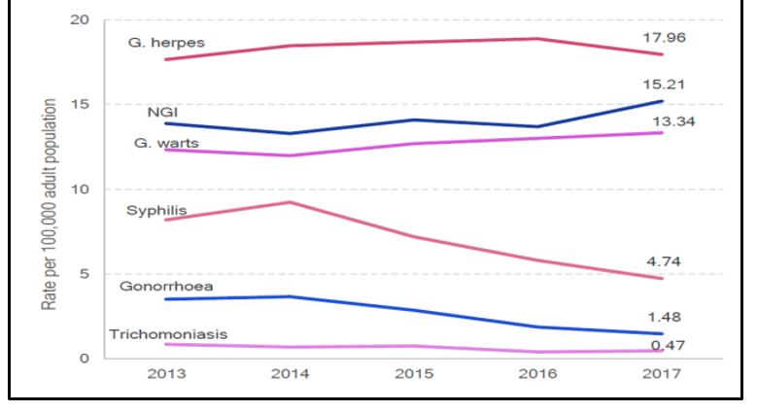
STI rates per 100,000 adult population (15+ years) in Sri Lanka, 2017
Source: Annual Report of the National STD/AIDS Control Programme 2017
- Dr. Ajith Karawita. MBBS, Pg Dip Ven, MD, FSLCoSHH

Slide 10
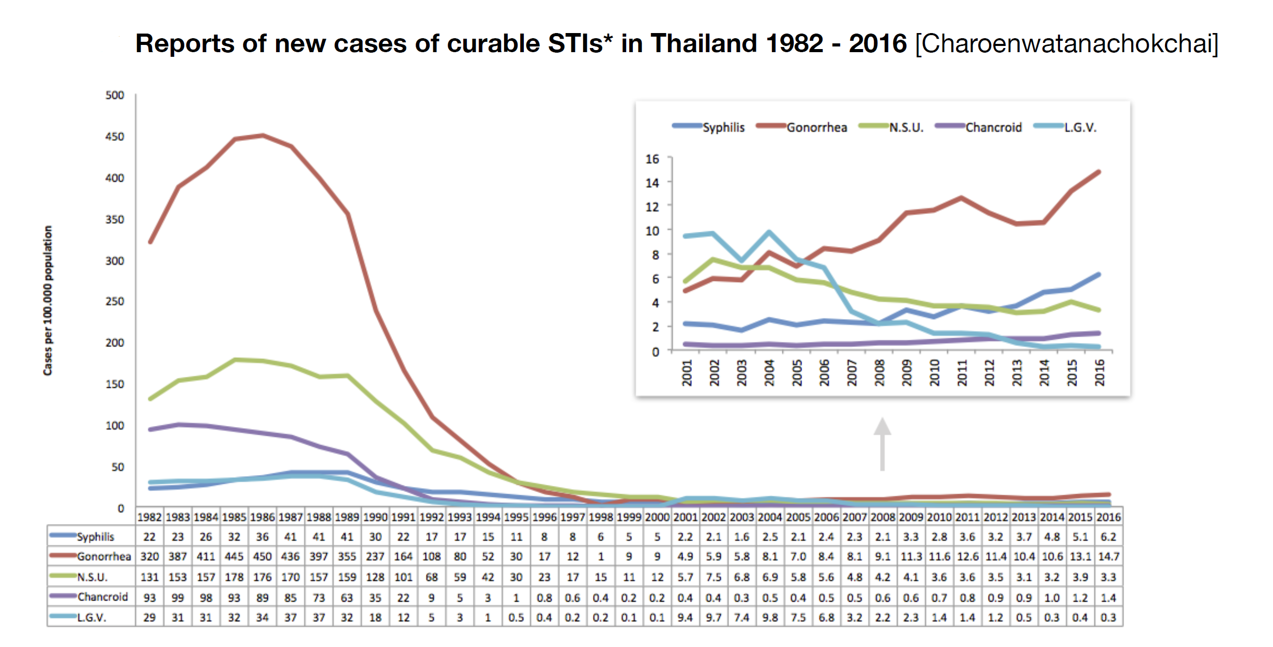
Laboratory-based, universal STI reporting, Thailand
Cases per 100,000 population
(Courtesy of Richard Steen & Iyanthi Abeyewickreme)

Slide 11
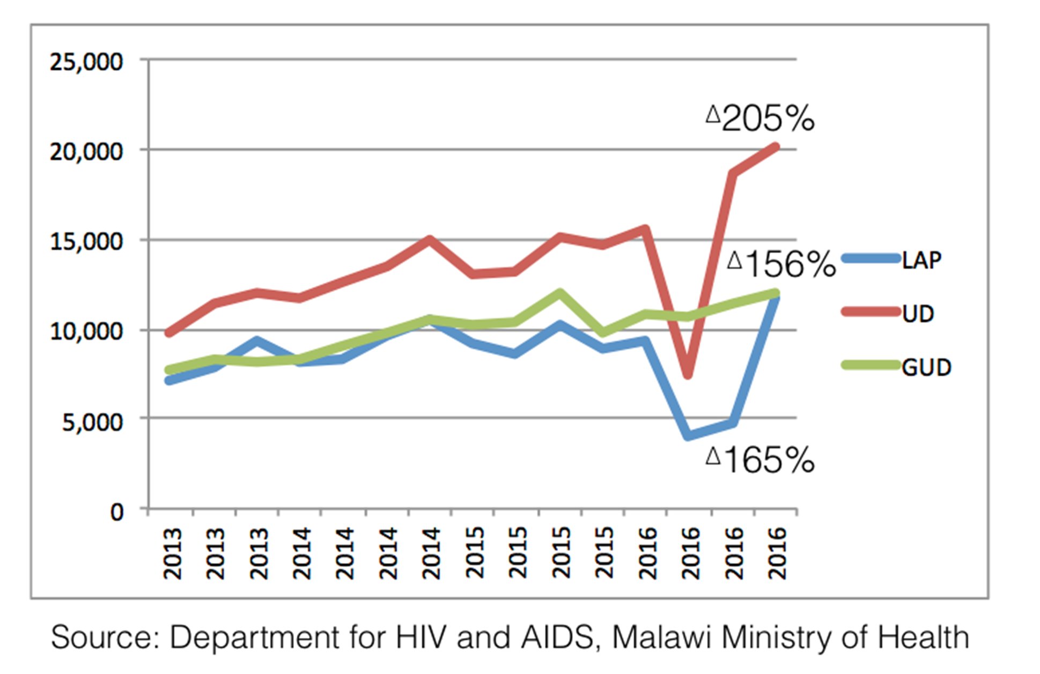
STI Syndromic reports in Malawi
(Courtesy of Richard Steen)

Slide 12
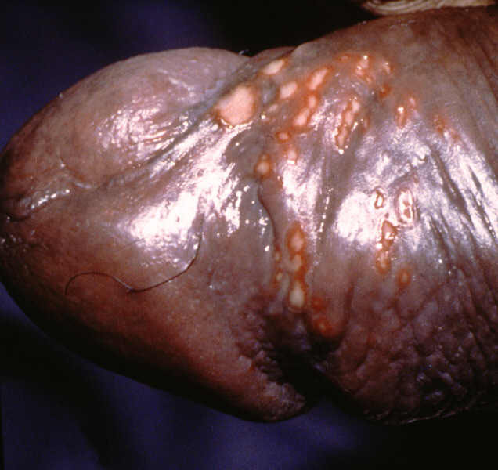
Agents causing genital ulcer disease in Africa over time
100%
90%
35
30
80%
Undetermined
70%
60%
8
Donovanosis
50%
10
LGV
40%
35
Chancroid
30%
45
Syphilis
20%
15
10%
HSV
0%
8
Before 1990's
After 1990's

Slide 13
Changes in the aetiology of GUD in Botswana from 1993 to 2002
0.9
0.8
0.7
0.6
0.5
1993
0.4
2002
0.3
0.2
0.1
0
HIV
TP
Syphilis
HD
HSV2
none
serology
*In 1993 a study was done by the National AIDS Control Program in Botswana in collaboration with the STD Research Unit, South African Institute for Medical Research, Johannesburg among 108 GUD patients.

Slide 14
Genital ulcer profile - men (Sri Lanka, 2001)
Aetiology of GUD by M-PCR and culture in Masaka, Uganda, 1999-2000
Genital ulcer profile - women (Sri Lanka, 2001)
N = 261
N = 115

Slide 15
Aetiology of Genital Ulcer Diseases in Zimbabwe, 2014 to 2015 by Multiplex Polymerase Chain Reaction
N=200
Source: M. Mungati et al. The etiology of Genital Ulcer Disease and Coinfections with Chlamydia trachomatis and Neisseria gonorrhoeae in Zimbabwe: Results from the Zimbabwe STI Etiology Study. Sex Transm Dis 2018;45:61-68.

Slide 16
Aetiology of genital ulcer disease in South Africa, 2014-2016 (N = 366)
Source: Ranmini Kularatne, Centre for HIV & STIs, NICD. Aetiological Surveillance of Sexually Transmitted Infection Syndromes at Sentinel Sites: Germs-SA 2014-2016. The Communicable Diseases Surveillance Bulletin, Volume 15. Issue 3 – November 2017. http://www.nicd.ac.za/index.php/publications/communicable-diseases-surveillance-bulletin/

Slide 17
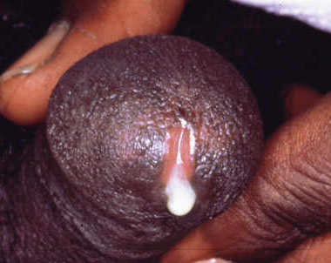
Aetiology of Urethral Discharge in Men in Zimbabwe, 2014 to 2015 by Multiplex Polymerase Chain Reaction
N=200
Source: CA Rietmeijer et al. The etiology of male Urethral Discharge in Zimbabwe: Results from the Zimbabwe STI Etiology Study. Sex Transm Dis 2018;45:56-60.

Slide 18
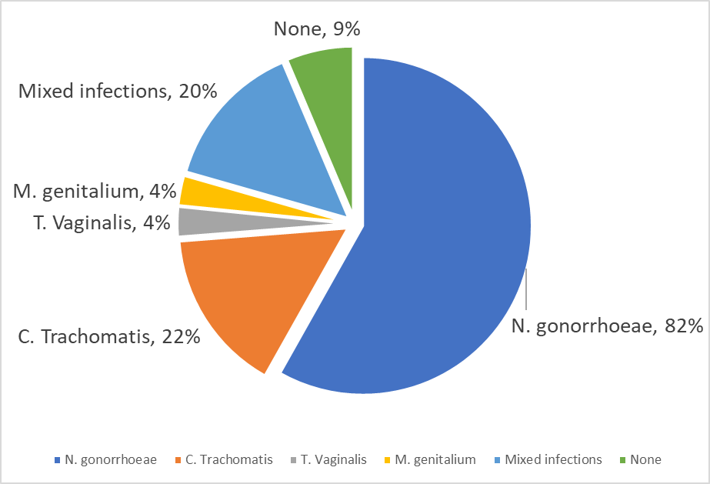
Overall prevalence of sexually transmitted pathogens in men presenting with urethritis in South Africa, 2014–2016 (N = 808)
Source: Ranmini Kularatne, Centre for HIV & STIs, NICD. Aetiological Surveillance of Sexually Transmitted Infection Syndromes at Sentinel Sites: Germs-SA 2014-2016. The Communicable Diseases Surveillance Bulletin, Volume 15. Issue 3 – November 2017. http://www.nicd.ac.za/index.php/publications/communicable-diseases-surveillance-bulletin/

Slide 19
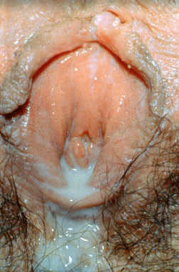
Aetiology of vaginal discharge syndrome in South Africa: 2014-2016

Slide 20
The HIV prevalence among patients presenting with STI syndromes in South Africa, 2014-2016
STI syndrome | N = | HIV co-infected | Per cent HIV positive
Genital Ulcer Disease | 363 | 208 | 57.3%
Vaginal Discharge | 742 | 350 | 47.2%
Male urethral discharge | 784 | 211 | 26.6%
There was a significant association between HIV seropositivity and all STI syndromes (p<0.001).
Source: Ranmini Kularatne, Centre for HIV & STIs, NICD. Aetiological Surveillance of Sexually Transmitted Infection Syndromes at Sentinel Sites: Germs-SA 2014-2016. The Communicable Diseases Surveillance Bulletin, Volume 15. Issue 3 – November 2017. http://www.nicd.ac.za/index.php/publications/communicable-diseases-surveillance-bulletin/

Slide 21
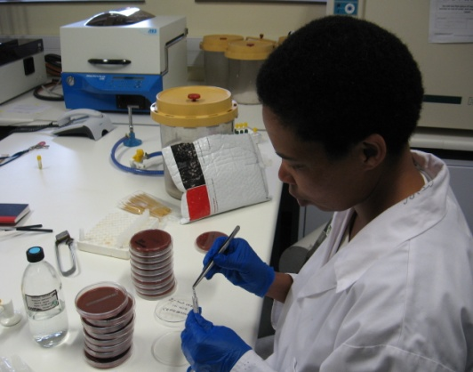
Antimicrobial Resistance

Slide 22
Countries participating in WHO Gonococcal Antimicrobial Surveillance Programme (GASP)
Notes:
81 countries

Slide 23
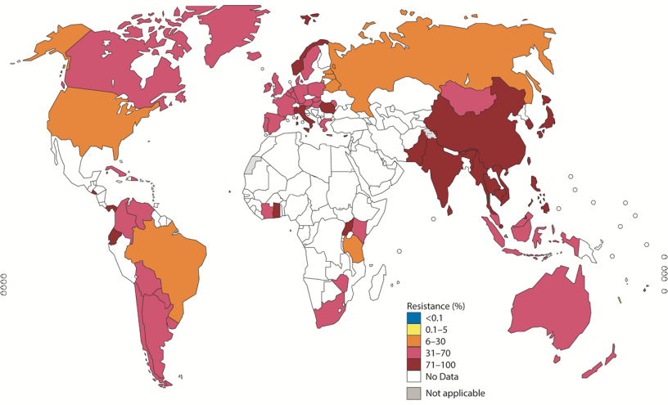
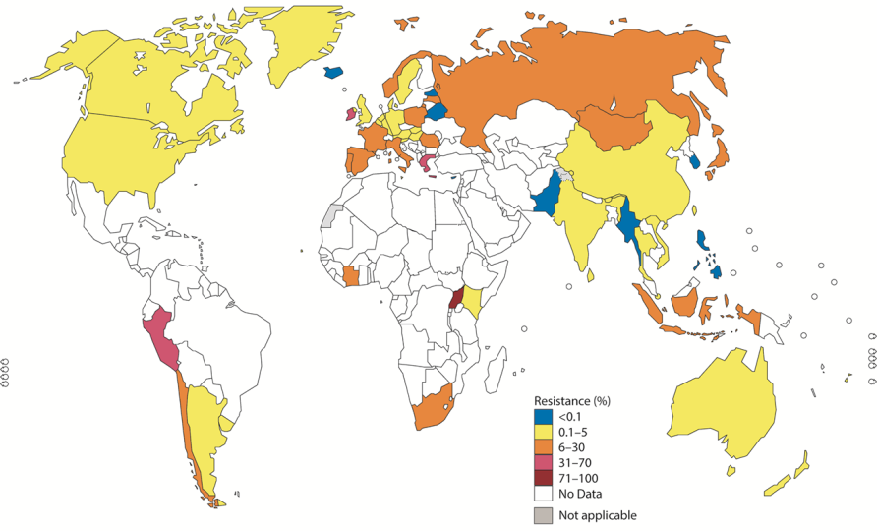
Countries with reported decreased susceptibility or with resistance to antibiotics for gonorrhoea GASP 2014
51/77 (66%) countries
decreased susceptibility to Cephalosporins
(26 countries ≥ 5%)
Superbugs reported in Japan, Spain and France
47/58 (81%) countries - resistance to azithromycin
(29 countries ≥ 5%)
70/72 (97%) countries resistance to ciprofloxacin
(14 countries ≥ 90%)
(52 countries ≥ 5%)
Wi et al PLOS Med

Slide 24
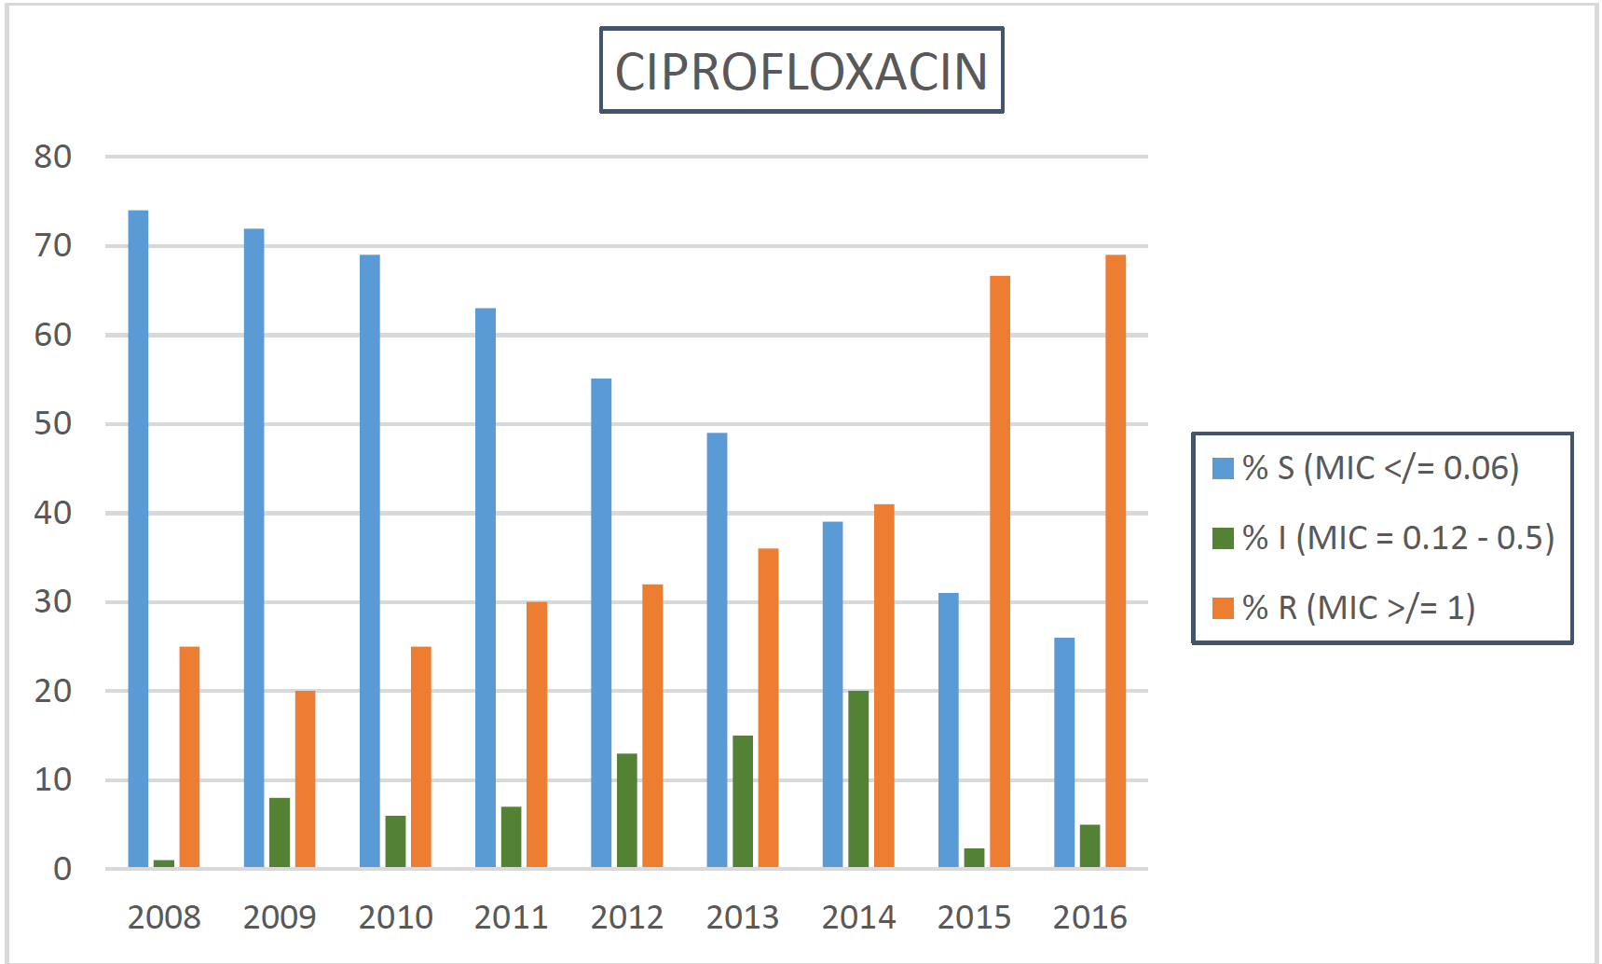
Trends in N. gonorrhoeae AMR over 10 years in Johannesburg, South Africa, 2008–2016
Antimicrobials tested: penicillin, tetracycline, ciprofloxacin.
MIC breakpoints: CLSI 2018, 28th Edition
Source: Ranmini K, et al. Trends in Neisseria gonorrhoeae Antimicrobial Resistance over a Ten-Year Surveillance Period, Johannesburg, South Africa, 2008– 2017. Antibiotics 2018, 7,58.

Slide 25
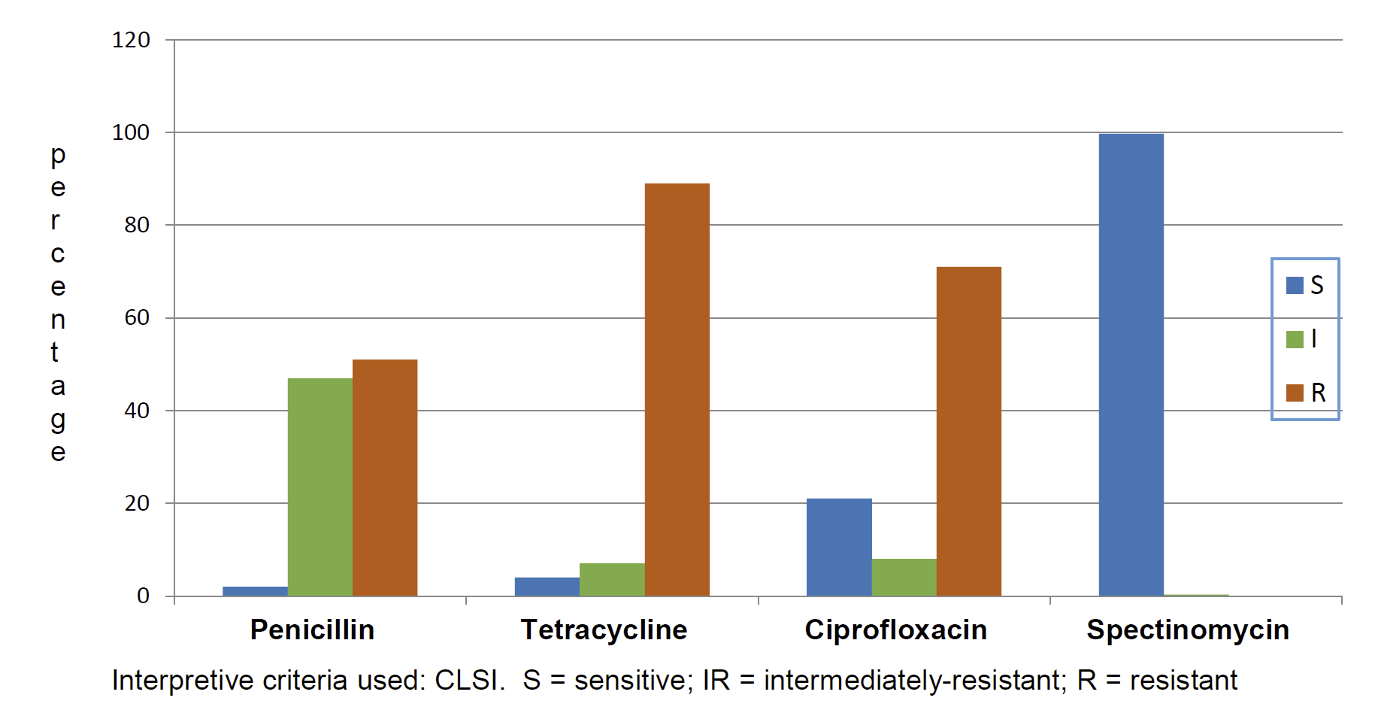
Neisseria gonorrhoeae antimicrobial susceptibility profiles, national sexually transmitted infection (STI) syndrome surveillance, South Africa, 2014 – 2016, (n = 330)
All were susceptible to Ceftriaxone, Cefixime and 99.4% were susceptible to Azithromycin

Slide 26
Take Home Messages
STIs are still a significant cause of morbidity requiring a public health approach to their prevention and control;
Herpes simplex virus infections have become the predominant cause of genital ulcerative diseases;
Gonococcal infections still predominate as causes of genital discharge diseases in sub-Saharan Africa;
Magnitude of the problem of AMR in STIs is not systematically surveyed, if at all, by Low- and Middle-income countries:
creates an unhealthy unknown in the control of the spread of antimicrobial resistance and effective management of STIs
“Classic” STIs and HIV have an epidemiological synergy in need of joint planning and collaboration at all levels of health-care.

Slide 27
Take Home Messages
Prevention is the key:
Primary prevention
Condoms
Vaccines
Point-of-care Diagnostic Tests
Effective treatments

